Slide 1
Football data Analysis
By
Vinay Simha M K
Batch code: ML3-DA23

Slide 2
Objective
This project involves analyzing Football data to identify insights into better team performance,
Strategies behind substitution, Rate of fouls, Variety of competition and player performance
And team performance,.
Problem Statement
The goal is to improve opposition analysis, identify key patterns and players, and develop
strategies to gain a competitive edge in matches and to identify contributing factors and
develop strategies to enhance overall consistency.
Area of focus:
Performance Analysis
Player Profile and Market Value
Team Comparison
Attendance and Stadium Analysis
Referee Analysis
Substitution Patterns
Event Analysis
Competition Analysis
Player attributes and demographics
Contract Management

Slide 3
About the Dataset:
Players table consists of name of the player, along with player code and country of birth
his position on field, kind of foot, height and value of the play, along with his agent's name
and contract duration.
Game lineup table consists of detail of lineup and the position of the player’s lineup and the
Game id along with Jersey number.
Games table consists data related to games played like Competition type,
Date of competition, home/away club goal counts and name, stadium where the match
took place, No of people attended to watch, referee identity, club names.
Game events table consists of data which are related to the events like, No of minutes player
played on field, player’s id, events took place during match like red/yellow card or goals or
assist.
In appearance table the data is related to the players status competition type, yellow card
count, red card count, goals counts, assists count, minutes played in a single go.

Slide 4
Business questions:
Which player have highest number of goals?
What is the average duration that’s been spent on the ground by players?
What is the total red card, yellow card that players got?
What is the market value of the players?
What is the highest market value of the players?
Stadium wise what is the average attendance?
Competition and the referee count?
Referees who have umpired most number of matches?
What is the frequency of substitution taking place during matches?
How many events taking place seasonally?
Year wise how many competition taking place?

Slide 5

Data Cleaning and Pre-Processing using Python.
Importing required libraries
Importing required data
Example of displaying info of the data
Example of checking for null
Some data imputing and dropping
Some data imputing and dropping

Slide 6

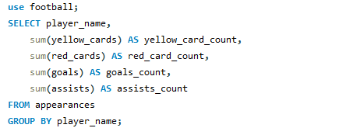
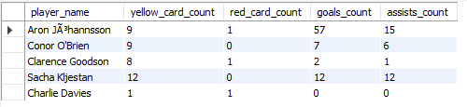
Using group by to fill the null values using mean
Merging all the tables to make it as one whole data
SQL
After merging the data, by using python SQL connector connecting python
With SQL and analyzing some business questions using SQL.
Some queries related to business question:
Query:
Output:
Query which is used to get the count of red/yellow cards, goals count and assists by players

Slide 7
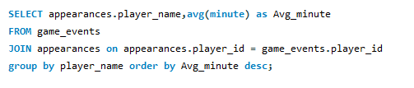
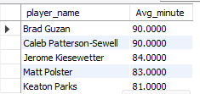
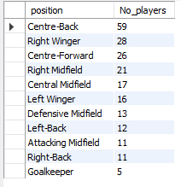

Query:
Output:
Query which say the average minute spent on field by players.
Query:
Output:
Query which says the no of players based on position type

Slide 8
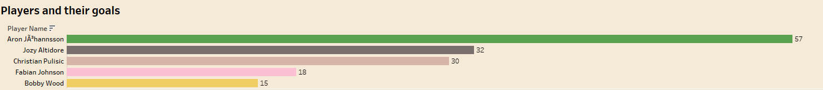
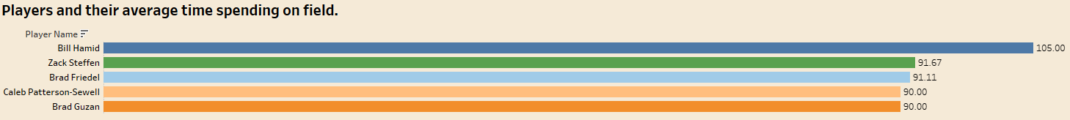
Business Questions:
Which player has highest number of goals?
Interpretation:
Player names Aron have highest number of goals that’s is 57.
What is the average time spent by the players on field.
Interpretation:
Player named Bill Hamid has spent 105 mins during his match, from this we can conclude
That overtime games has been more for him

Slide 9
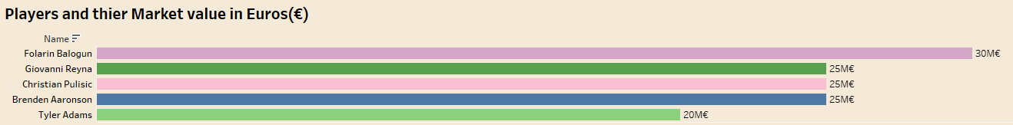
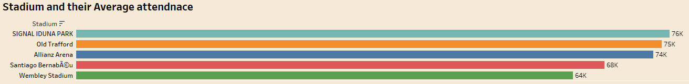
Market value of the players?
Interpretation: Player names Folarin Balogun has highest market value of 30M€
Based on Attendance, which is the biggest stadium?
Interpretation:
Stadium names “SIGNAL IDUNA PARK” has highest average attendance of 76k.

Slide 10
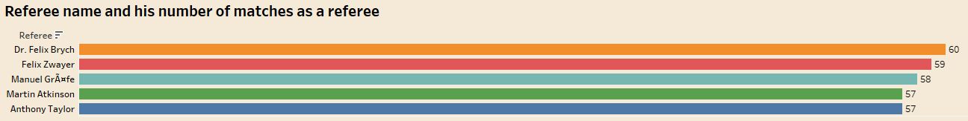
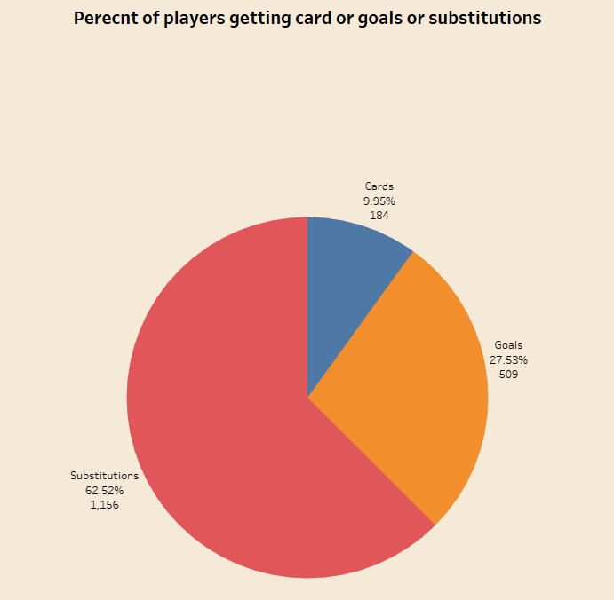
Which referee has officiated in the most number of matches as a referee/umpire?
Interpretation:
A Referee named Dr. Felix Brych has been referee for most number of matches.
What is the ratio between Goals, Cars and Substitution?
For Cards -> 9.96% (184)
For Goals -> 27.53% (509)
For Substitution -> 62.52% (1156)
From this we can conclude that in 60% of matches
Substitution takes place no matter what. Cause of strategy
Of the Teams.

Slide 11
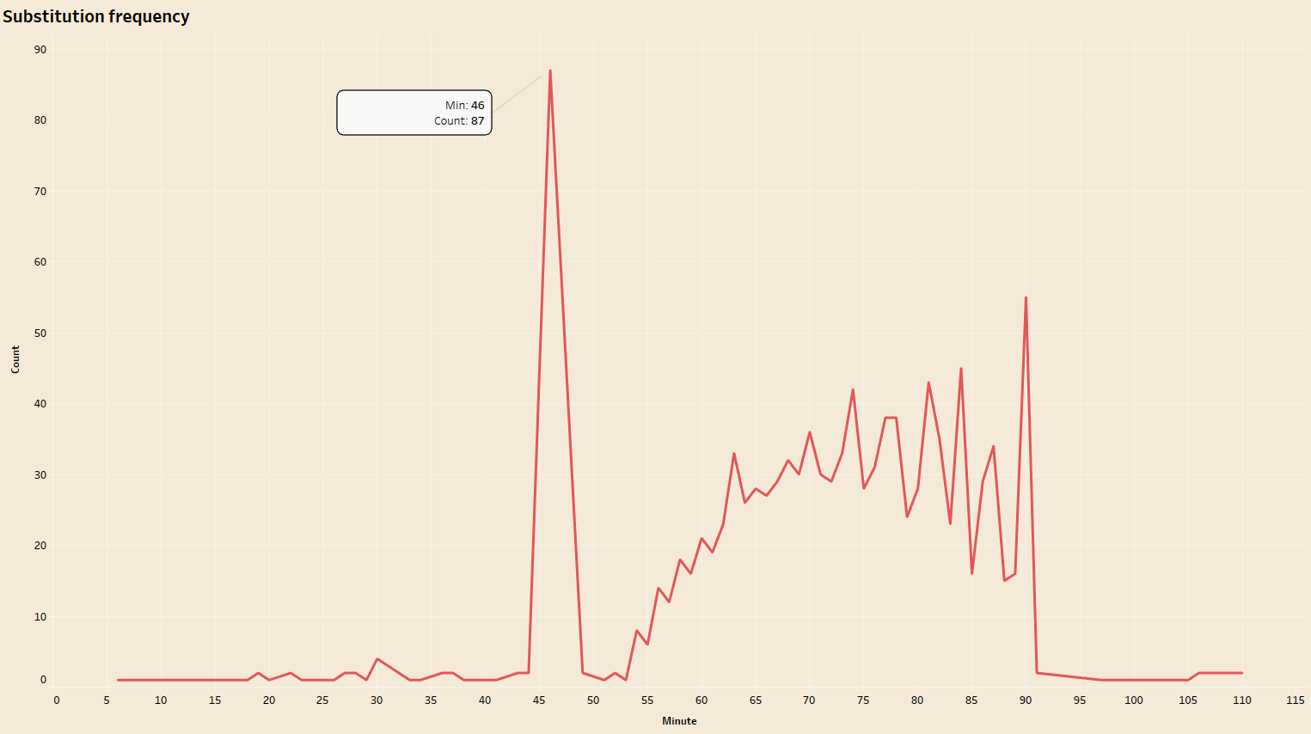
Occurrence of substitution or Substitution analysis:
Interpretation:
Mostly substitution occurs after half time of the match and from there to end of the match
depending upon strategy of the team substitution is taking place.

Slide 12
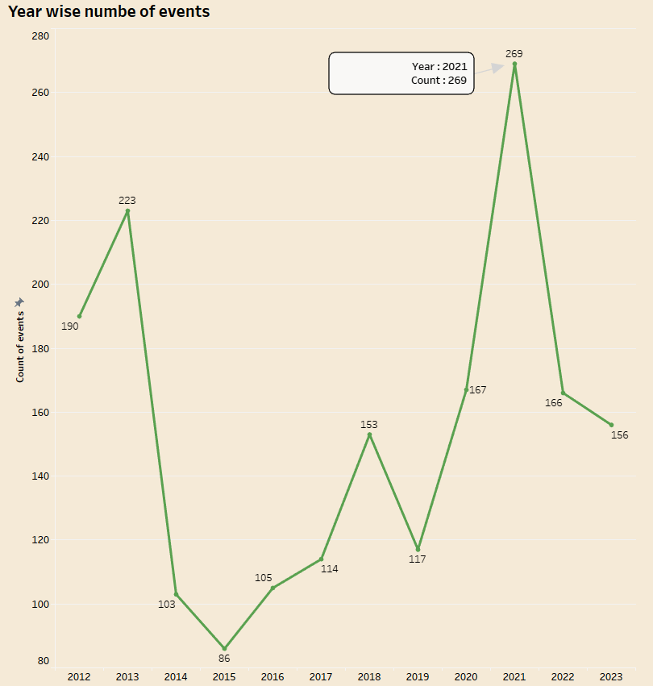
Occurrence of events year wise?
The highest number of events occurred in 2021 which is total of 269 events.

Slide 13
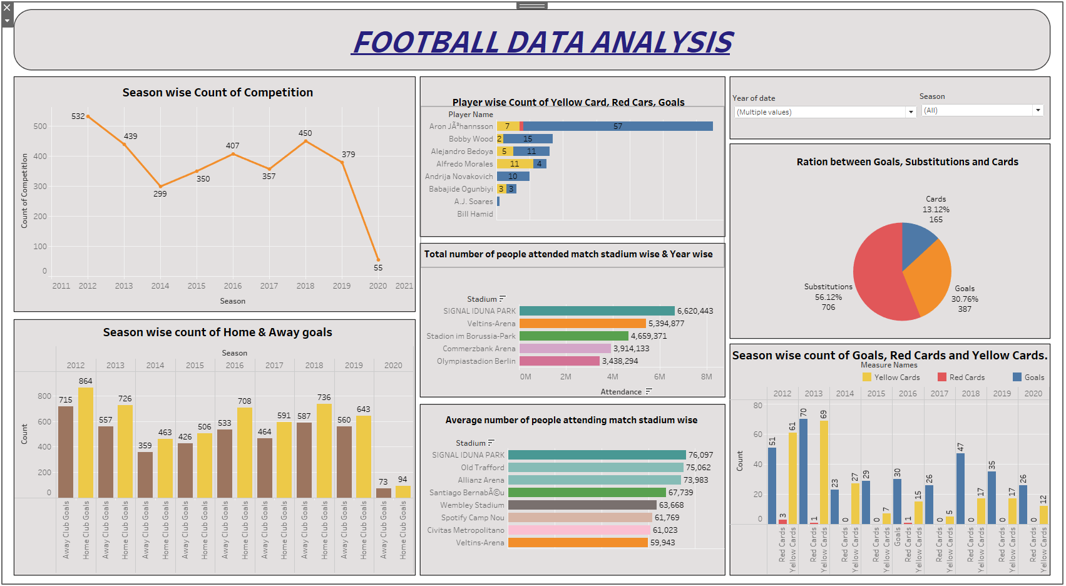
Final Analysis:

Slide 14
Summary:
In 2012 the number of competition was at peak and later began to downfall.
Overall, in 2012 since there was high number of matches compared to other
the number of away club goals and home club goals are high compared to other years.
Player names Aron has high number of goals and player named “Alfredo Morales” has high
number of yellow cards.
A stadium named SIGNAL IDUNA PARK has most number of attendance compared to others
which is approximately 6.6M.
The above stadium has highest average of attendance as well which is 76K.
Overall, around 60% there is possibility of substitution to take place and 30% of goals and
10% of getting Cards.
* In 2013 the Goals as well as Yellow card rate is high and 2012 the red card rate is high.

Slide 15
Thank you

